Slide 1
Color2Gray-Salience-Preserving Color Removal
Presented by- FNU Akanksha

Slide 2
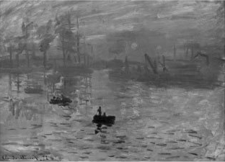
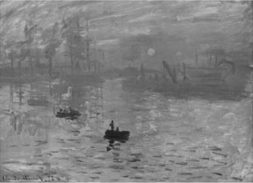
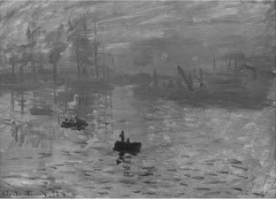
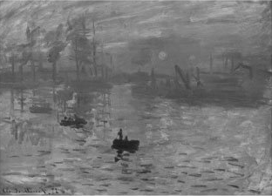
Traditional Methods: Luminance Channels
Problem can not be solved by
simply switching to a different space
As colors can map to same gray colors.
Also Contrast enhancement & Gamma Correction Doesn’t help with isoluminant values
CIE CAM 97
Photoshop LAB
CIE XYZ
YCrCb

Slide 3
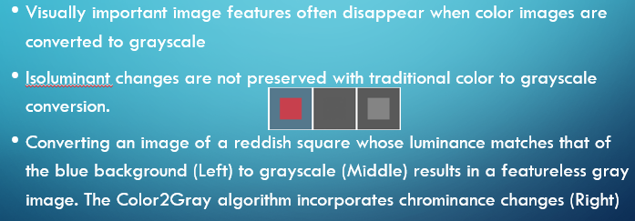
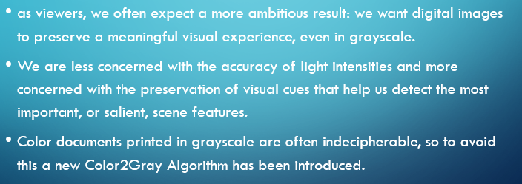
Problem

Slide 4
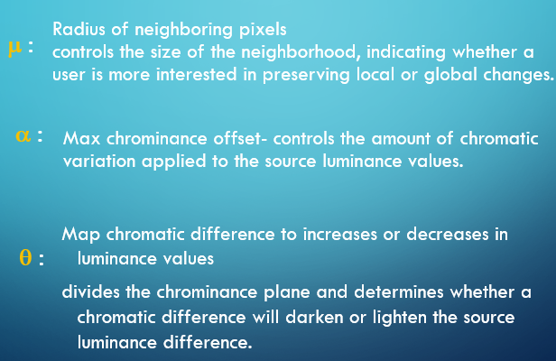
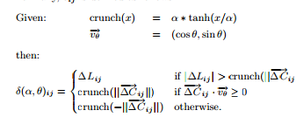
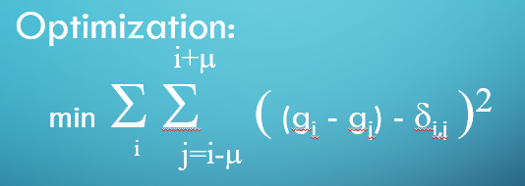
Solution – Color2Gray Algorithm
Convert to Perceptually Uniform Space
CIE L*a*b*
Initialize image, g, with L channel
For every pixel
Compute Luminance distance
Compute Chrominance distance
δ_{ij}
Adjust g to incorporate both luminance and chrominance differences

Slide 5
Implementation-
There is a main function which is taking the input and preparing it by using imread and rgblab and then calling the functions for calculating the neighbor pixels. After that the delta matrix (included a function to calculate crunch and cartesian)is calculated and then optimization is applied to get the result (misc.imsave that takes the path and grayscale matrix as input and converts to output.)
The input image is converted and then it is saved in the same directory with _bw extension.

Slide 6
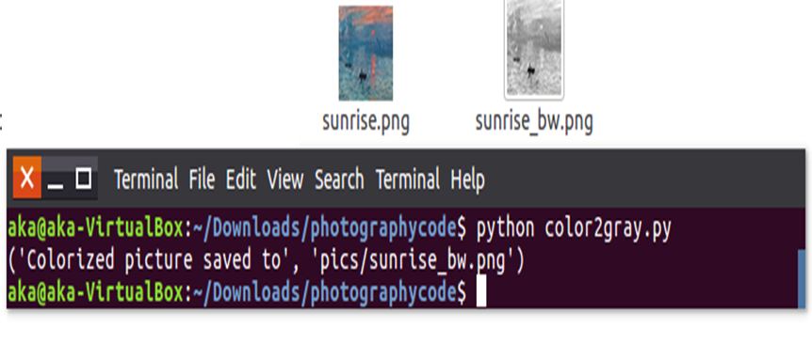
Results:

Slide 7
Summary:
- A system which takes input as the color images and converts it into the gray scale image which preserves the salient features of the images, by following the mentioned algorithm.
-Technologies using –Python
- The Colored input images are successfully converted to the grayscale images by using the given algorithm.
Although, it does not provide large improvements for scenes with high dynamic range, especially natural scenes, which typically have a wide range of luminance changes
This method does improve any image that contains large isoluminant regions with a small number of different chrominance values such as the last row

Slide 8
Thank You
Questions?

